Slide 1
A Journey with Git and GitHub
Hasan Mahmud Rhidoy
Software Development Engineer, BRAC IT
Dhaka, Bangladesh

Slide 2
What is Git?
Git is an open-source distributed version control system.
It is designed to handle minor to major projects with high speed and efficiency.
The version control allows us to track and work together with our team members at the same workspace.
Git can be used privately and publicly.
Git is easy to learn, and has fast performance.

Slide 3
Git History
Git was created by Linus Torvalds in 2005 to develop Linux Kernel.

Slide 4
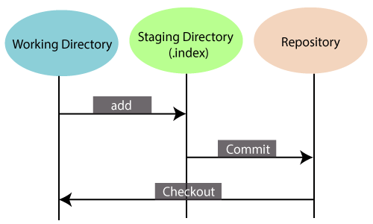
Features of Git
Some remarkable features of Git are as follows:
Open Source: Git is an open-source tool. It is released under the GPL (General Public License) license.
Scalable: Git is scalable, which means when the number of users increases, the Git can easily handle such situations.
Distributed
Security
Speed
Branching and Merging
Staging Area
Maintain the clean history
Saves Time
Offline Working
Undo Mistakes
Track the Changes

Slide 5
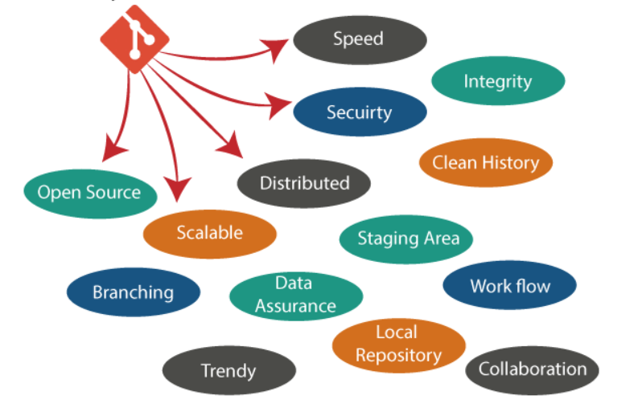
Why Git?
We have discussed many features and benefits of Git that demonstrate the undoubtedly Git as the leading version control system.

Slide 6
Prerequisites
Git is not a programming language, so you should have the basic understanding of Windows/Linux commands only.

Slide 7
What is GitHub?
GitHub is a Git repository hosting service.
GitHub also facilitates with many of its features, such as access control and collaboration. It provides a Web-based graphical interface.
GitHub is an American company. It hosts source code of your project in the form of different programming languages and keeps track of the various changes made by programmers.
It offers both distributed version control and source code management (SCM) functionality of Git.

Slide 8
Features of GitHub
Some of its significant features are as follows.
Collaboration
Integrated issue and bug tracking
Graphical representation of branches
Project management
Team management
Track and assign tasks

Slide 9
Benefits of GitHub
The key benefits of GitHub are as follows.
It is easy to contribute to open source projects via GitHub.
It helps to create an excellent document.
You can attract recruiter by showing off your work. If you have a profile on GitHub, you will have a higher chance of being recruited.
You can track changes in your code across versions.

Slide 10
Git vs GitHub
Git is a revision control system, a tool to manage your source code history.
GitHub is a hosting service for Git repositories.
So they are not the same thing: Git is the tool, GitHub is the service for projects that use Git.

Slide 11

Install Git on Windows/Linux/MacOs

Slide 12
<<Command>> : Git config
The Git config command is the first and necessary command used on the Git command line.
This command sets the author name and email address to be used with your commits.
git config --global user.name “Hasan Mahmud”
git config --global user.email “hasan.mahmud8177@gmail.com”

Slide 13
<<Command>> : Git init
The git init command is the first command that you will run on Git.
The git init command is used to create a new blank repository.
It is used to make an existing project as a Git project.
The git init command creates a .git subdirectory in the current working directory.
It also initializes a HEAD pointer for the master branch of the repository.
git init
touch filename.txt [Create a file]

Slide 14
<<Command>> : Git Add
The git add command is used to add file contents to the Index (Staging Area).
This command updates the current content of the working tree to the staging area. It also prepares the staged content for the next commit.
Every time we add or update any file in our project, it is required to forward updates to the staging area.
git add <File_Name>
git add . / git add -A

Slide 15
<<Command>> : Git Add Undo
We can undo a git add operation. However, it is not a part of git add command, but we can do it through git reset command.
git reset <filename>

Slide 16
<<Command>> : Git Commit
It is used to record the changes in the repository.
It is the next command after the git add. Every commit contains the index data and the commit message.
When we add a file in Git, it will take place in the staging area. A commit command is used to fetch updates from the staging area to the repository.
git commit –m “Message”

Slide 17
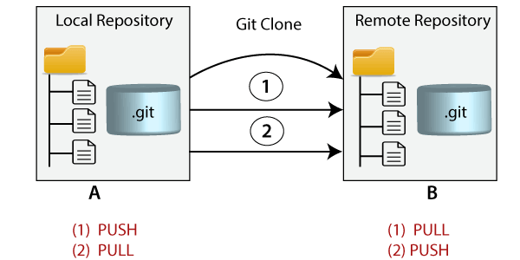
<<Command>> : Git Clone
In Git, cloning is the act of making a copy of any target repository.
git clone <repository_url>

Slide 18
<<Command>> : Git Push

Slide 19
<<Command>> : Git Pull

Slide 20
<<Command>> : Git Clone and Merge Request

Slide 21
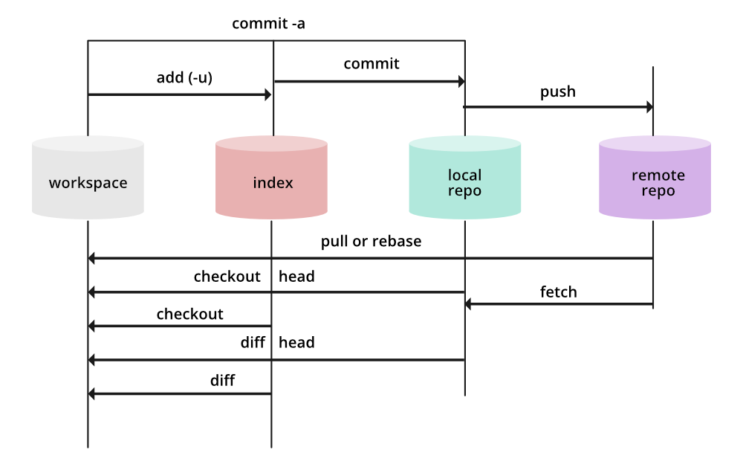
Git Index

Slide 22


